Slide 1






PINDUODUO
Why Did PDD Take Off ?
— A platform economics-based
perspective.
April 18th, 2025
Group 1: Kai Ren, PeiHua Ji, JunWen Luo, FeiFan Xu,
Lei Cheng, Chang Li
Team Up, Price Down!
Team Up for Savings | Deals | Welcome Surprises !
Notes:
Hello everyone, we are group1, I am RenKai.
It’s a great honor to share our Project With you.
Our project is Why Did PDD Take Off ?
And we are going to answer this question from a platform economics-based perspective, which we have learnt in this module.

Slide 2

PINDUODUO
PART O1
Platform
Introduction
PART O2
Theoretical Analysis
PART O3
Extension
PART O4
Conclusion
Team Up, Price Down!
Team Up for Savings | Deals | Welcome Surprises !
Notes:
To fully anaysis this question, we are going to talk about the four parts.
First is the platform introduction, and then theoretical analysis.
Aftter that we will do some extension discuss, and draw the conclusion in the end.

Slide 3



PART 01
Platform Introduction
PINDUODUO
Team Up, Price Down!
Team Up for Savings | Deals | Welcome Surprises !
Notes:
The first part is platform introduction.

Slide 4



1.1 Take Off of PDD
Pinduoduo (PDD) is a mainstream e-commerce platform on China's mobile internet.
It is a third-party social e-commerce platform that specializes in C2M group shopping.
Users can initiate group purchases with friends, family, neighbors, etc. to buy goods at lower prices.
Founder
Huang Zheng
Created
September 2015
Revenue
GMV
Number of Active Buyer
Taking Off !
Fig 1.1 PDD Revenue and Growth Rate
(2016 – 2022 Q3)
Fig 1.2 PDD GMV and Growth Rate
(2017 – 2021)
Fig 1.3 PDD Active Buyer and Growth Rate
(2017 – 2021)
Notes:
I think most of us have used PDD, featured by the C2M group shopping and buy goods at lower prices,
PDD has been a mainstream e-commerce platform on China’s mobile internet.
As the bottom figures show, Revenue, GMV, Number of Active Buyer of PDD is taking off duing the past years.

Slide 5
1.2 Development Path
2021
2019
“Ten Billion Agricultural Research” program was announced.
In June, launched a “10 billion yuan subsidy”. GMV breaks through “trillion”.
2017
2015
September, its annual active buyers exceeded 200 million.
April, Pinhaohuo was launched on WeChat.
2023
2020
Market capitalization surpassed Alibaba's for the first time.
DuoDuo Grocery was launched in August.
The number of annual active buyers on the platform reached 730 million.
2018
2016
Officially listed on NASDAQ in July.
2024
September, Pinduoduo official account launched. Two weeks fans broke ten thousand.
“Ten Billion Relief” program was announced.
PDD has achieved steady growth and a rapid rise !
Data Source: MinSheng Securities (2025.01.17)
Notes:
We can also see this from the development Path, this is no doubt that PDD has achieved steady group and a rapid rise, which we call taking off !

Slide 6
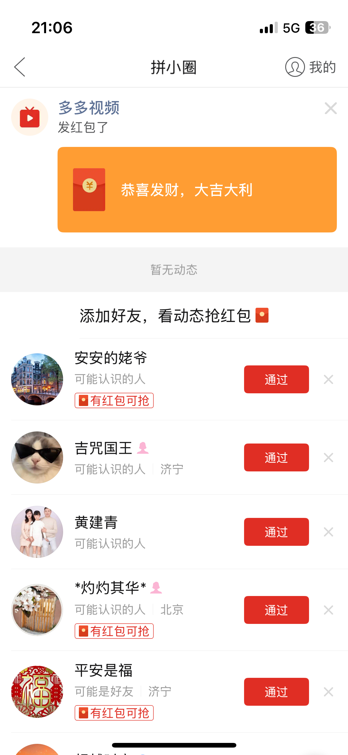
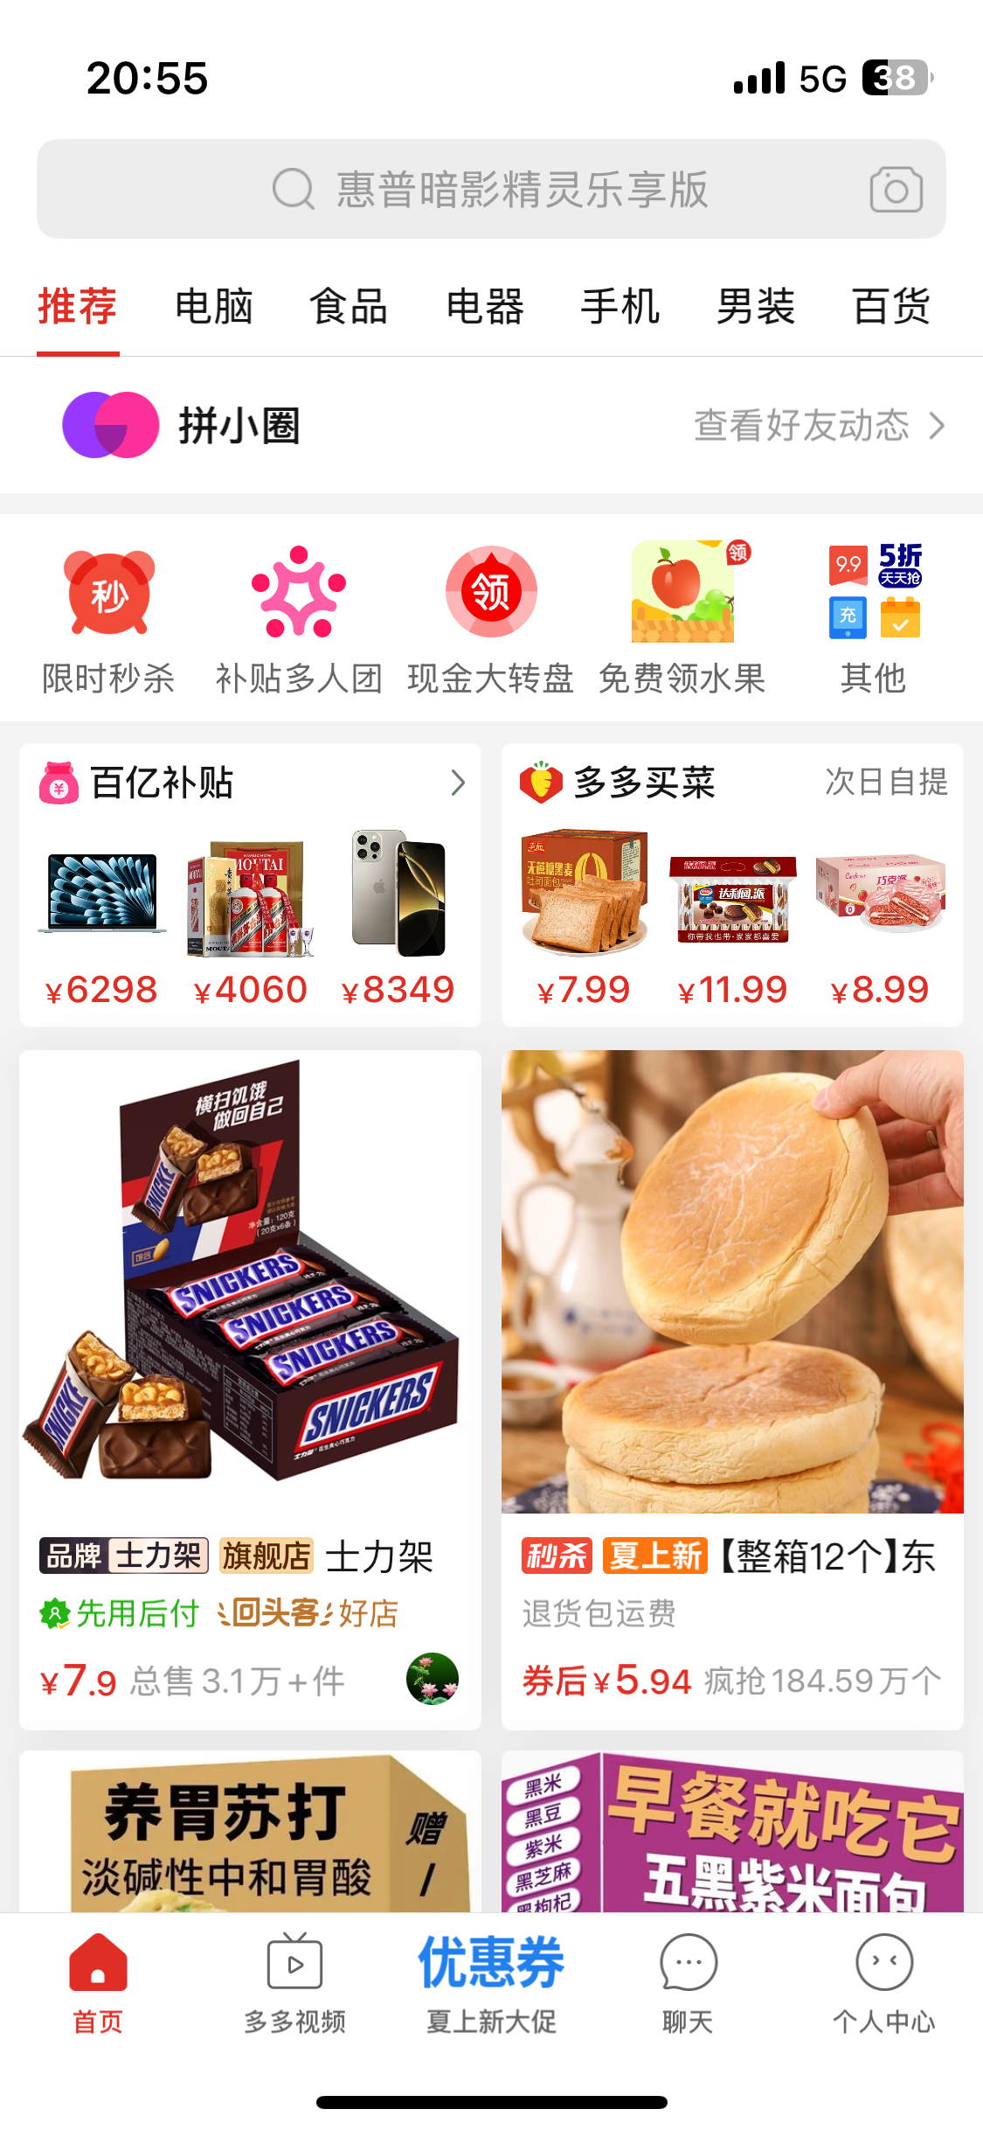
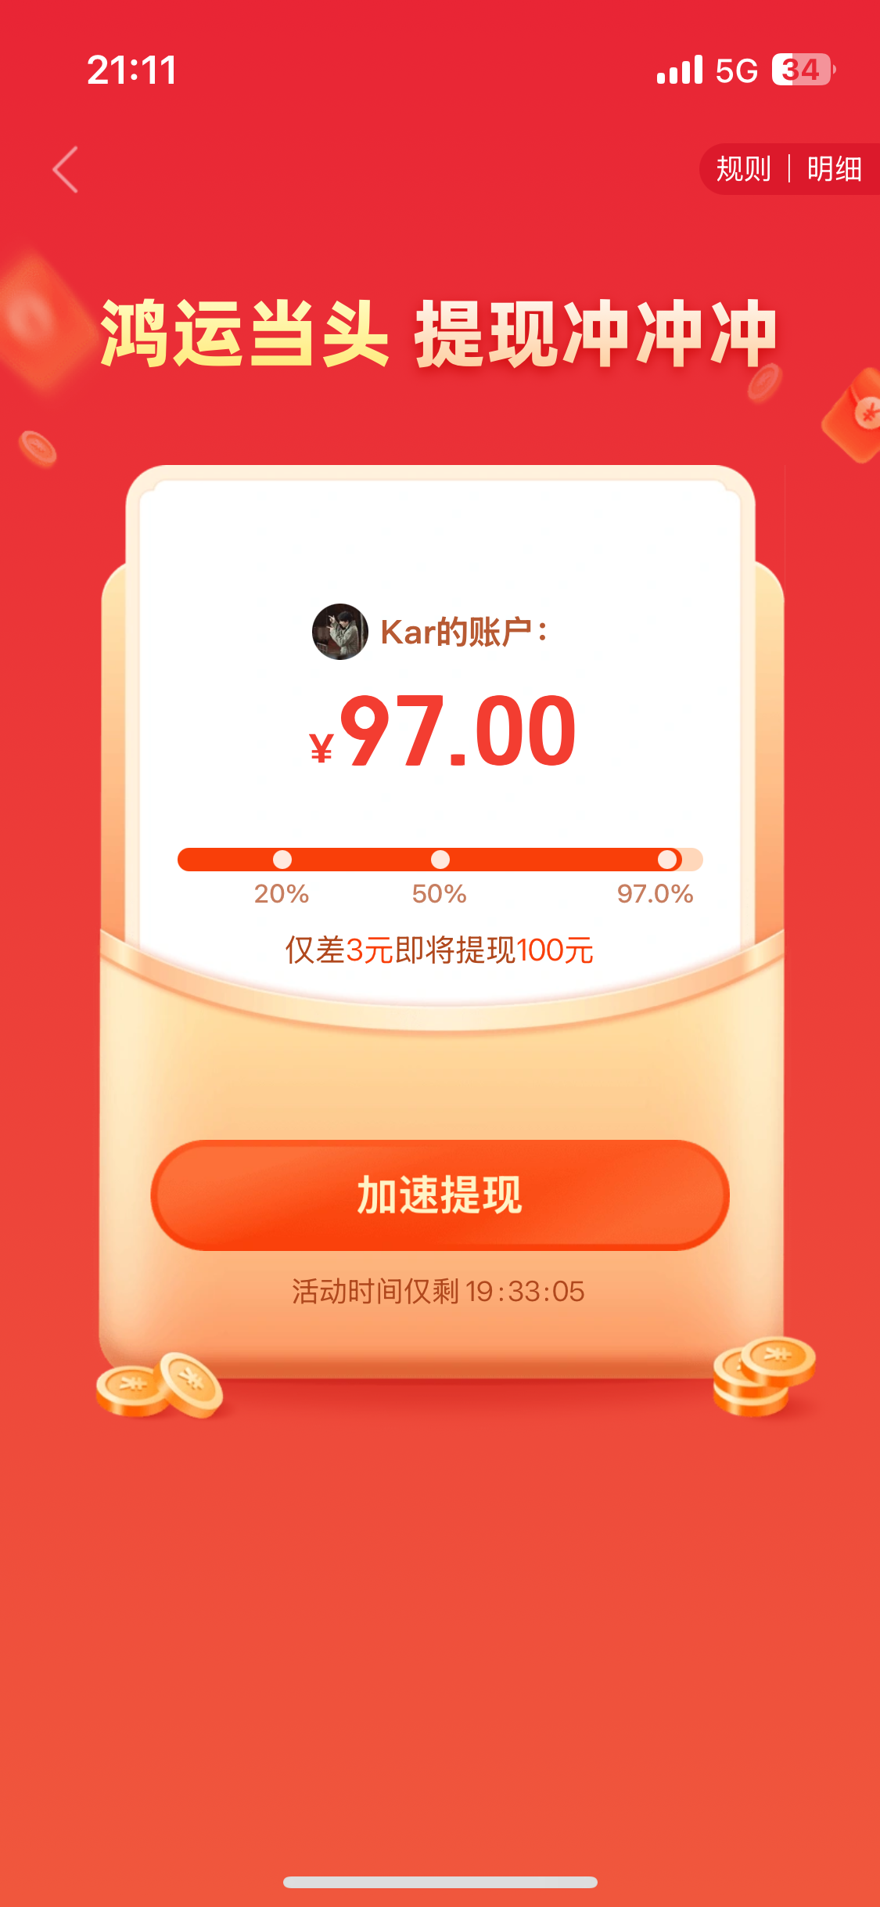
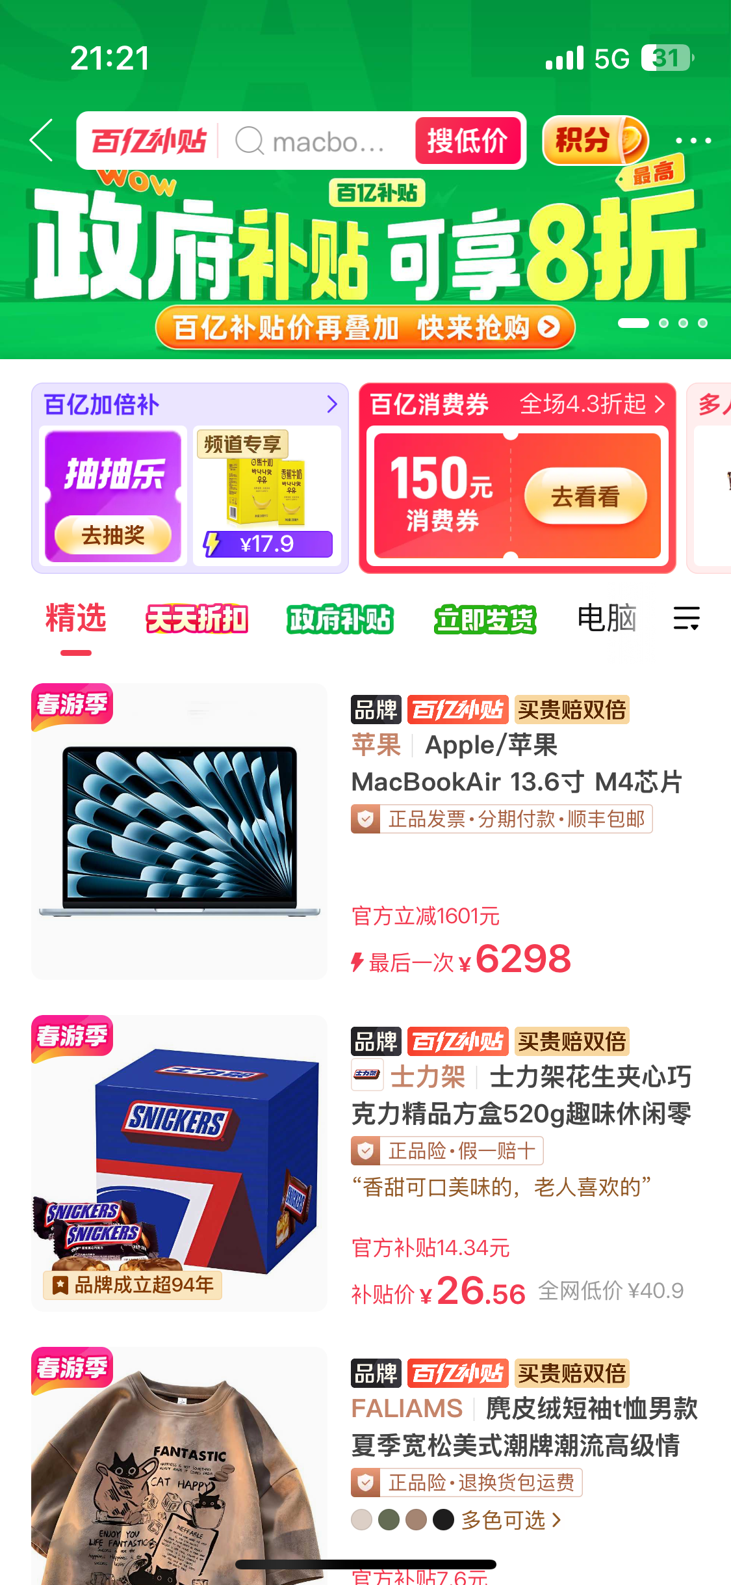
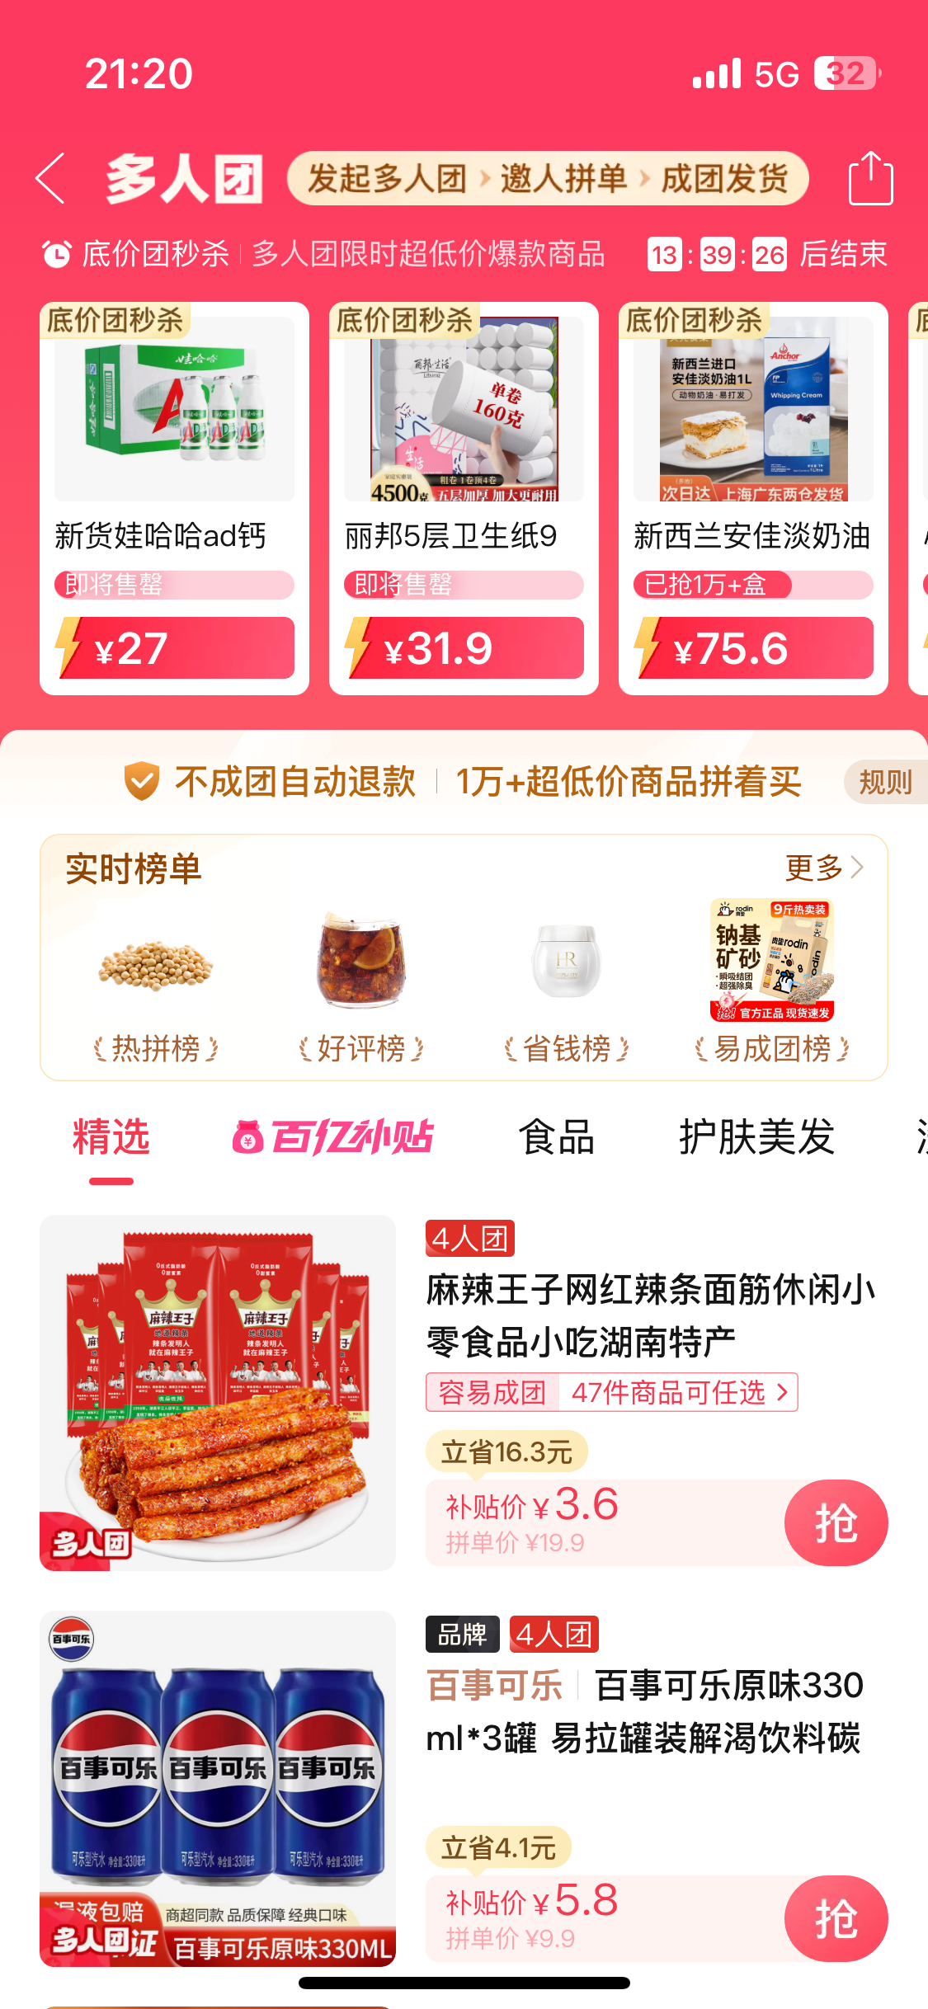
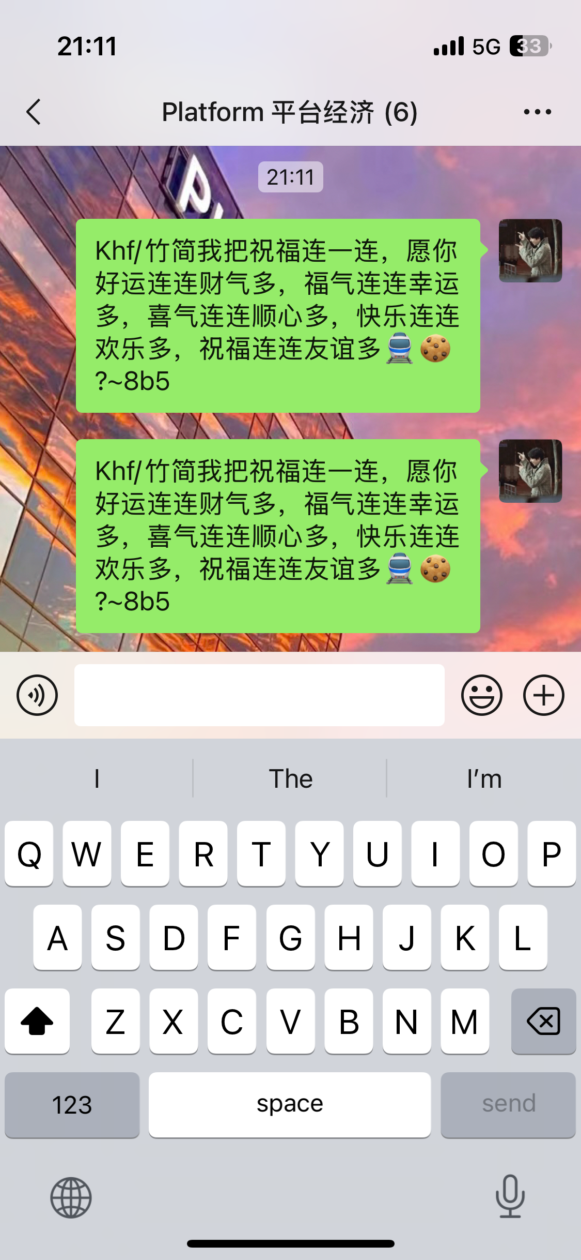
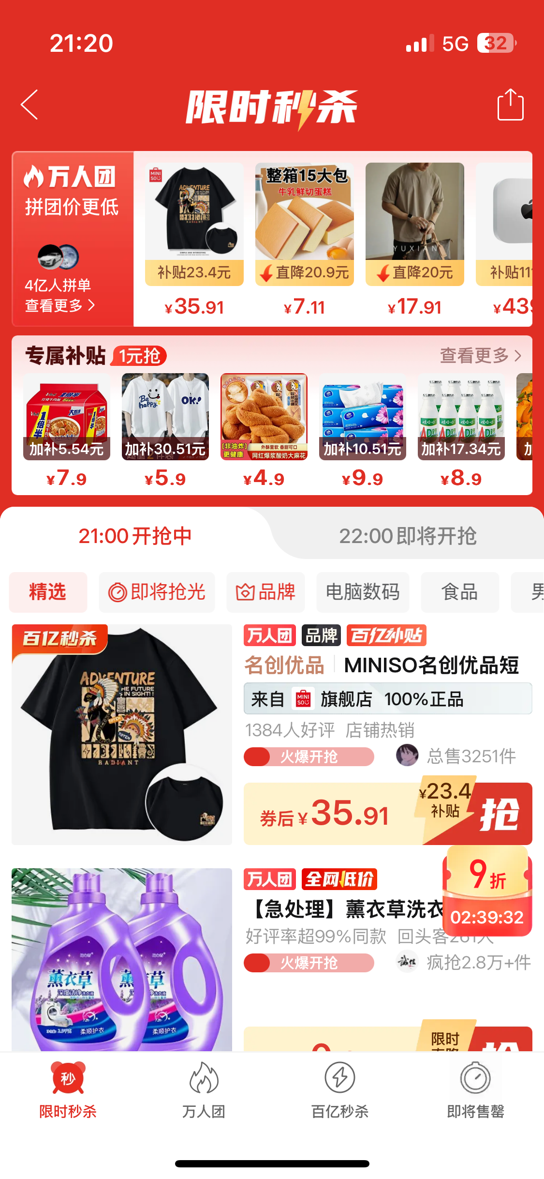
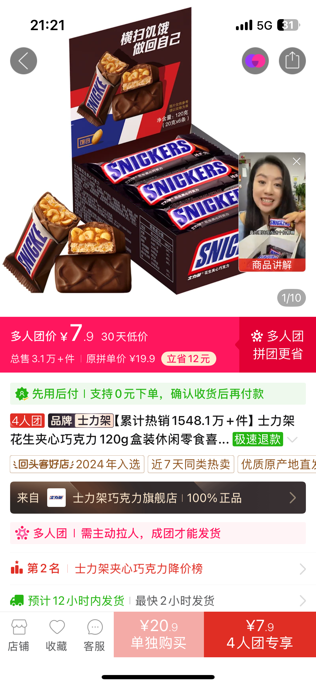
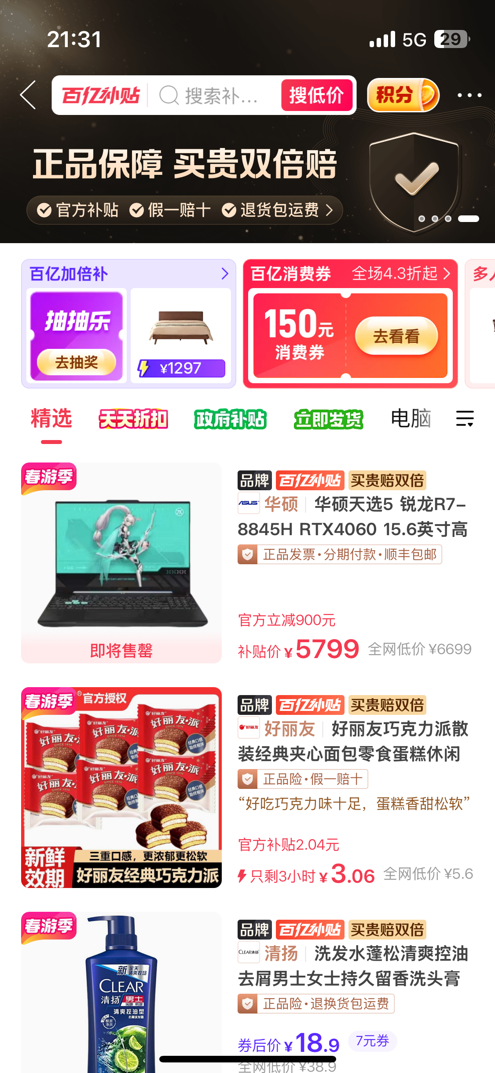
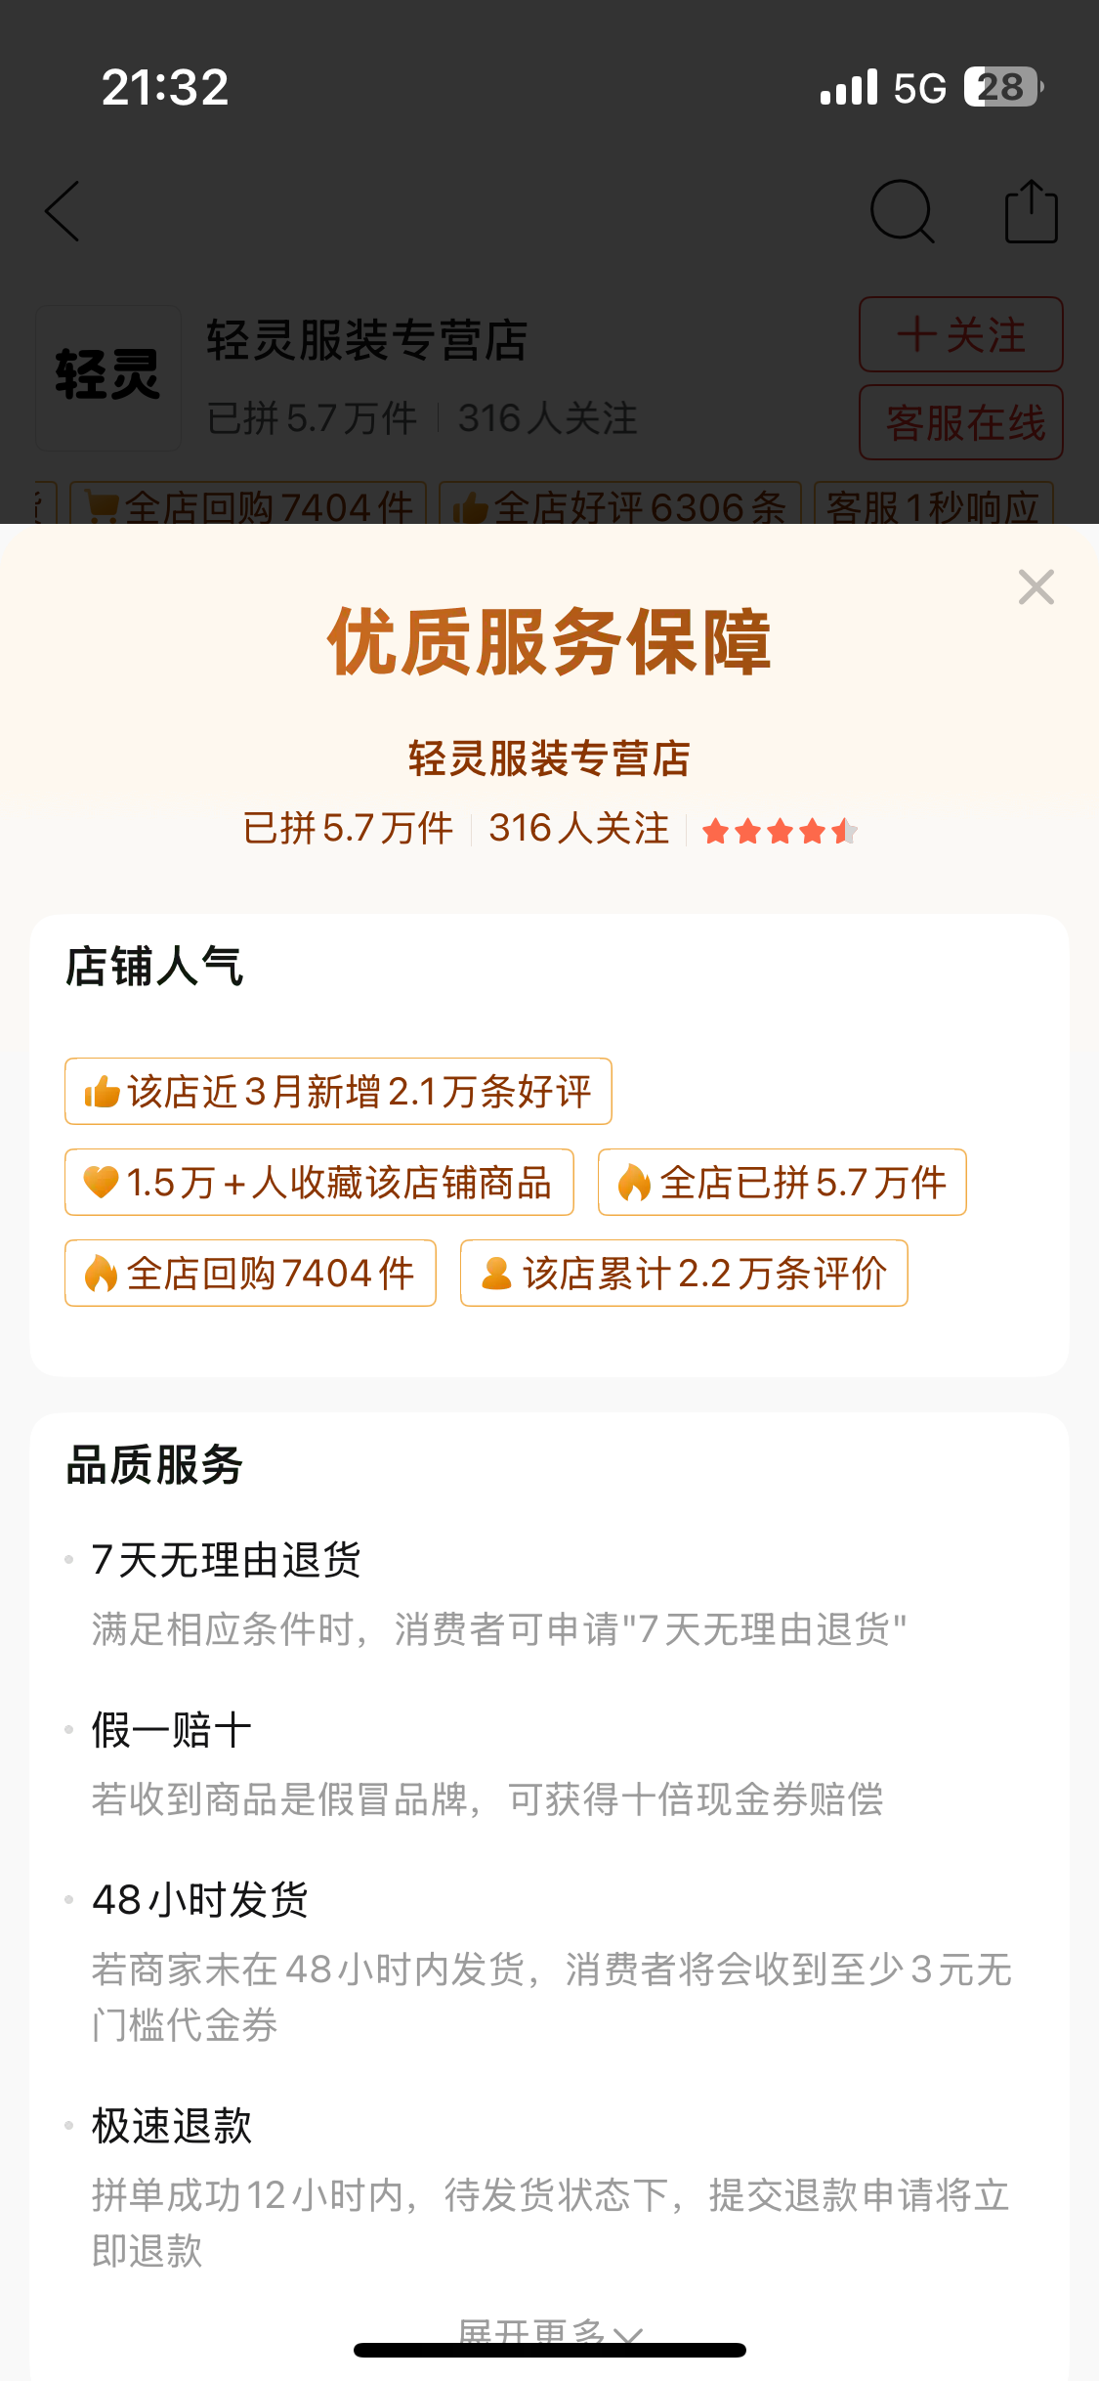
1.3 Platform Overview
14 primary classifications for searching.
Circle of Friends in PDD to build friendships.
4. Recommendation System
Invite Friends
for Cash
1. Network Effect
3. Online
Reputation
2. Platform Pricing
6
Notes:
Now if you pick up you phone and open PDD, you can find there are four main parts of it.
The first is the circle of friends in PDD and invite friedns for cash, which using the network effect.
The second is the well known special pricing mechanise, 拼团 and 百亿补贴 let buyers can get the products in low price.
And also there are the online reputation system and recommendation system.

Slide 7
Project Framework
WeChat Traffic
PDD "Products Find People"
Team Up for Low Price Logic
PDD Introduction
Why PDD Take Off ?
Theoretical Analysis
How does PDD deal with the problem of fakes ?
1. Network Effect
2. Platform Pricing
User
Initial
Group Buying
Group Buying Formation
Group Buying Formation
3. Online
Reputation
4. Recommendation
System
Aggregated
Demand​​
Small Profits
but
Quick Turnover​​
Social Fission
Join
Group Buying
Extension
Can PDD’s path to success be replicated ?
What is the future direction of PDD ?
​​Third-Party Logistics
Conclusion
7
Notes:
Now, we have seen the whole picture of PDD and we can summary It as the Products Find People logic.
The framework is drived as right, our start point is discussion why PDD take of, we will use the theoretical analysis to answer it, especially some obviors question: how …
After that, we will know the operation theory and do future extension, talking about can PDD’s to success be replicated and what is the future direction of PDD
Finally, we draw the conclusion.

Slide 8
PART 02
Theoretical
Analysis
PINDUODUO
Team Up, Price Down!
Team Up for Savings | Deals | Welcome Surprises !
Notes:
Let’s enter to the part 2.

Slide 9

2.1.1 Direct and Indirect Network Effects Overview
Direct Network Effects
b)Customer Acquisition: User Referral
Relying on WeChat's huge flow
Existing/seed users
“grouping” is easy to realize
a) Attract Flow: WeChat
Sinking market socialization is tight
Indirect Network Effects
Diversifica-tion of products & low prices
Mass production by merchants
Demand Aggregation
More user attraction and retention
More user attraction and retention
Stronger competition among merchants
Attract more merchants
c)Customer Retention: Low-price Attraction
attract flow
a) Attract Flow → b) Customer Acquisition = Direct Network Effects b) Customer Acquisition → c) Customer Retention = Indirect Network Effects
Notes:
"I will talk about the network effects of Pinduoduo. For Pinduoduo, getting users is more difficult, so this part will mainly focus on the user side.
Here's a general overview. I will use the main steps of operation: attracting traffic, getting customers, and keeping them, as the story line to explain network effects.
As you can see in this diagram, direct network effects are mainly at play from attracting traffic to getting customers.
Indirect network effects are at play from getting customers to keeping them. Now, I will explain these two parts in detail."

Slide 10
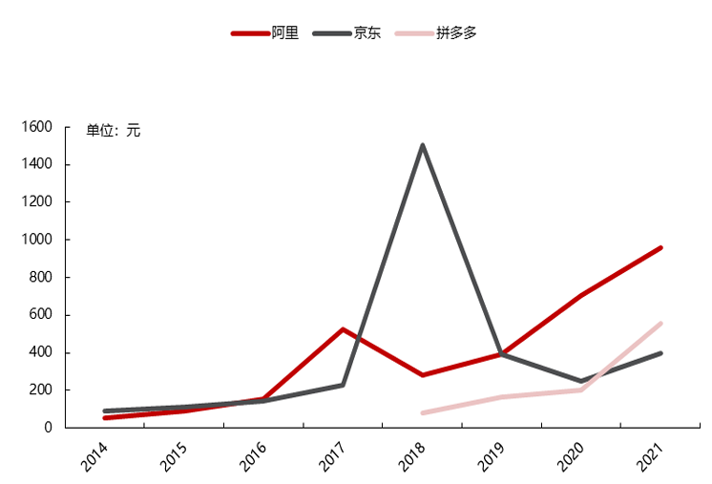


2.1.2 Direct Network Effects
PROCESS
Relying on WeChat's huge flow
“Grouping” is easy to realize
More user attraction and retention
Existing/seed users
a) Attract Flow: WeChat
Sinking market socialization is tight
b)Customer Acquisition: User Referral
Precondition
Key Factor
Core Strategy
Low CAC
01
02
03
04
WeChat for Attraction
Sinking Market
Group Purchase
Viruses-Like Spreading Model
Of PDD
Easy to sign-up
Seamless integration
Viral spread
Low-cost sharing
Bargain Slash,“砍一刀”
Sharing red packets
Group buying with acquaintances.
……
Price-sensitive “sinking users”
Utility: price savings > social cost
Tight Social circles thus easy to spread
attract flow
Purpose —— Reducing Customer Acquisition Cost (CAC).
Notes:
The starting point for Pinduoduo to achieve direct network effects by carrying out the process of 'attract flow & Costumer acquisition' through WeChat.
Attract flow: Pinduoduo makes it easy to sign up by using WeChat login. Also, can quickly spread among users.
Costumer acquisition: a. Because it's connected to WeChat, Users share with people they already know, so people trust it more. b. Pinduoduo specifically targeted the ‘Sinking Market', who are large in number, very sensitive to prices, and have close social connections.
WeChat and Sinking Market helped Pinduoduo's most well-known marketing method, 'group buying': WeChat greatly lowered the cost of starting direct network effects. Price discounts from 'group buying' are very appealing to the Sinking Market, and the large number of people provided a good environment for 'group buying' to spread quickly. This eventually greatly reduced the Customer Acquisition Cost."

Slide 11
2.1.3 Indirect Network Effects
PROCESS
b)Customer Acquisition: User Referral
PDD: “Billion Subsidies”
Diversifica-tion of products
&
Lower prices
Mass production by merchants
Demand Aggregation
More user attraction and retention
More user attraction and retention
Stronger competition among merchants
Attract more merchants
c)Customer Retention: Low-price Attraction
Benefits
attract flow
Merchant Side
User Side
Of indirect network effects
Attracting Merchants
Increase in User Benefits
Notes:
Finally, after getting a huge number of users, indirect network effects start to work:
1. The huge number of users is attractive to sellers. More and more brands are joining Pinduoduo, which increases competition and leads to lower prices
2. Users' demands are brought together through group buying. This allows sellers to produce products in large amounts, which lowers the price of goods.
3. Billion Subsidies is a direct way Pinduoduo lowers prices. It helps make the indirect network effects stronger by attracting many high-quality brands.
These three ways make Pinduoduo's low prices sustainable and help them keep more users by using low prices as a main selling point."
Besides, through these three ways, indirect network effects achieve the benefits of Attracting Merchants and Increasing in User Benefits. This provides the continuous power for Pinduoduo's ecosystem to grow.

Slide 12
2.1.4 Result of direct & indirect network effect
Network Effects Cycle
attract flow
Direct Network Effects
Indirect Network Effects
Users
Merchants
Order in groups
Aggregating demand by group buying
Mass production
Product-to-Consumer
Attracts more new users
Small profits but quick sales
Lower price
Notes:
"The presence of both direct and indirect network effects ultimately leads to the following positive cycle:
On the customer side, social 'group buying' brings together many individual demands (which is the direct network effect). On the seller side, this then allows products to be made in large quantities (which is the indirect network effect). So they can achieve 'small profits but high sales'.
This changes how online shopping used to be, from Taobao’s 'customers searching for products' to 'products to customers'. By bringing together demand, they can customize the supply chain to achieve low prices. They then use these low prices as their main way to attract more customers, which creates a continuous positive cycle.

Slide 13

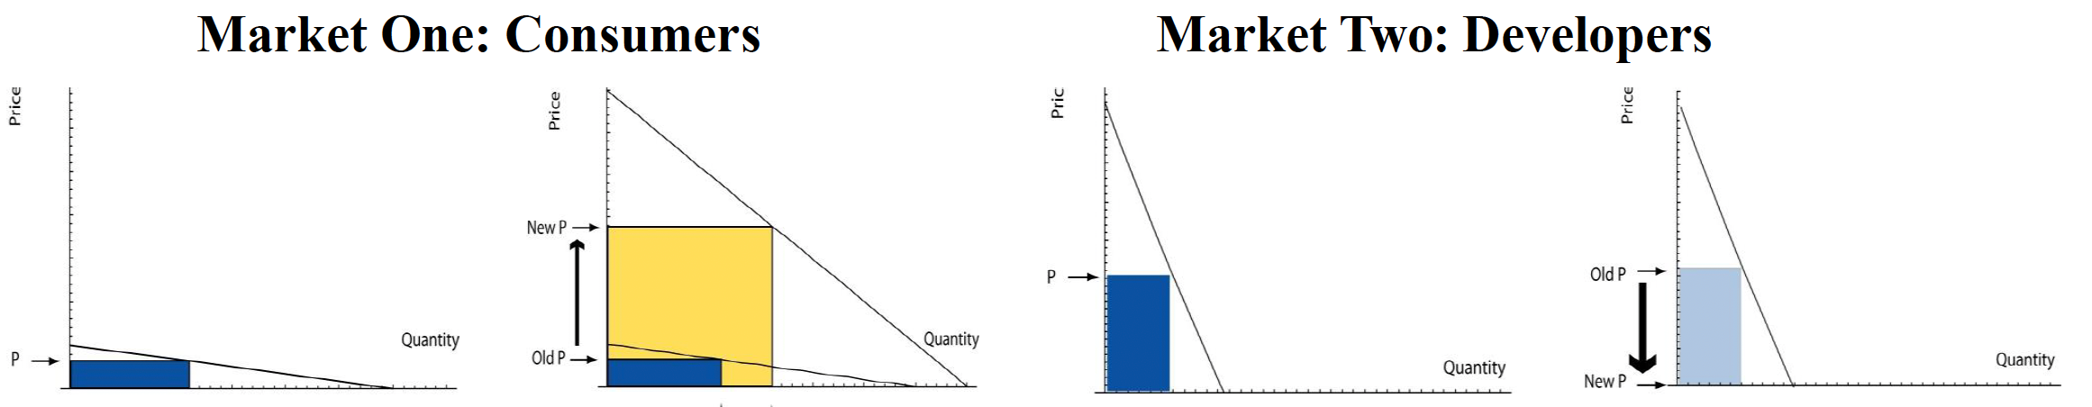
2.2.1 Divide-and-conquer strategy
PDD dominates China's e-commerce through social group buying and direct factory sales. By cutting middlemen and using WeChat's network, it delivers ultra-low prices to cost-conscious shoppers nationwide. Its C2M model and gamified promotions make online shopping affordable across all city tiers.
Platform | Profit making group | Subsidized group
PDD | Merchants | Consumers
Notes:
next part, we're gonna to talk about the platform pricing strategy of PDD, and we will use two models we talked in the class to analyze PDD's pricing strategy, which are divide and conquer strategy and two-sided market pricing. In PDD, the profit making side is the merchants and the subsidized side is consumers.

Slide 14

2.2.1 Divide-and-conquer strategy
Why do platforms have the ability to adopt this pricing strategy ?
01
02
03
04
Attract Sellers
Reduce Costs
Squeeze
Supplier Margins
Subsidize Users
Low-Cost Entry & Traffic Support
Streamlined Supply Chain
Viral Discounts & “Lowest Price” Branding
Strict Pricing Control
Zero/low fees: Early no-commission policy (later minimal fees) lowers entry barriers.
Social traffic: Group-buying via WeChat enables viral exposure without ads.
Farmers’ support: Zero fees, logistics aid, and traffic priority for direct farm-to-consumer sales.
Bid-based ranking: Sellers compete on price for visibility.
Bulk order discounts: Group buys lock in lower supplier prices.
Penalties: Fines for delays/defects balance low prices with reliability.
“Billions Subsidies”: Discounts on iPhones/Dyson to attract premium shoppers.
Social sharing: Group buys/referral discounts drive low-cost acquisition.
Gamification: E.g., “Duo Duo Orchard” rewards engagement with free produce.
C2M model: Direct factory-to-consumer sales, using data to guide production.
Simplified marketing: Algorithm-driven “goods-find-people” promotions cut ad costs.
3PL logistics: Outsourced delivery with bulk discounts.
Notes:
So Why do PDD have the ability to adopt this pricing strategy?
First, is "Attracting Sellers". Platforms achieve this through zero-commission policies and low barriers to entry. By leveraging social group-buying like WeChat, they provide sellers with free traffic exposure.
Next is "Reducing Costs". PDD implement the C2M (Customer-to-Manufacturer) model to connect producers directly with consumers, eliminating middlemen. They utilize big data for demand forecasting, coupled with AI-powered recommendations and third-party logistics partnerships to minimize operational expenses.
Third, is "Squeezing Supplier Margins". Through competitive bidding systems and group purchase discounts, platforms force suppliers to lower prices. Strict penalty mechanisms ensure service quality isn't compromised despite the lower pricing.
Finally, is "Subsidizing Users". The "Billions Subsidies" program attracts premium shoppers with discounted luxury items, while gamified features such as "Duo Duo Orchard" reinforce the platform's "lowest price" position.

Slide 15
2.2.1 Divide-and-conquer strategy
PDD
Commodity profit
More user scale
On PDD, pricing depends not only on the demand and cost from marginal cost and elasticity of demand, but also on how their participation affects participation on the other side, and the profits associated with the other side.
Network effect externalities
Low price attraction
Enjoy the product
Merchants
Consumers
Make money
Notes:
So to summarize on PDD, they use lower price to attract more consumers, and then there will be more merchants join PDD by the network effect, that's all how divide and conquer strategy applied on PDD.

Slide 16
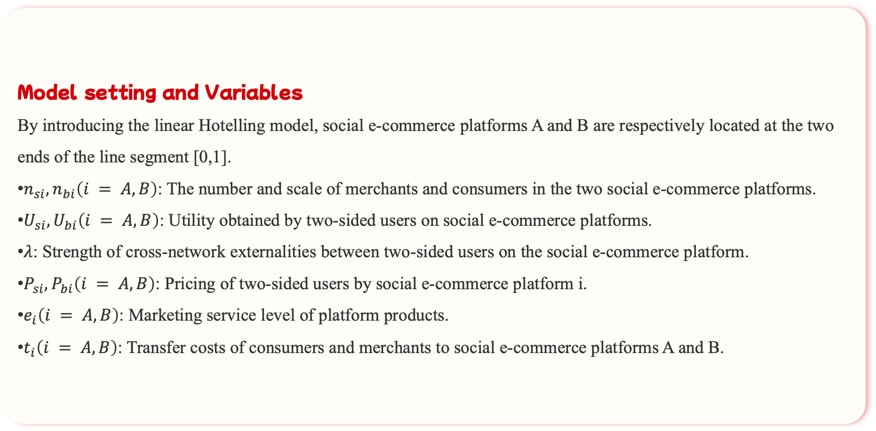
2.2.2 Two-sided Market Pricing
Model setting and Variables
By introducing the linear Hotelling model, social e-commerce platforms A and B are respectively located at the two ends of the line segment [0,1].
$n_{si},n_{bi}\left(i = A, B\right)$: The number and scale of merchants and consumers in the two social e-commerce platforms.
$U_{si},U_{bi}\left(i = A, B\right)$: Utility obtained by two-sided users on social e-commerce platforms.
$λ$: Strength of cross-network externalities between two-sided users on the social e-commerce platform.
$P_{si},P_{bi}\left(i = A, B\right)$: Pricing of two-sided users by social e-commerce platform i.
$e_{i}\left(i = A, B\right)$: Marketing service level of platform products.
$t_{i}\left(i = A, B\right)$: Transfer costs of consumers and merchants to social e-commerce platforms A and B.

Slide 17
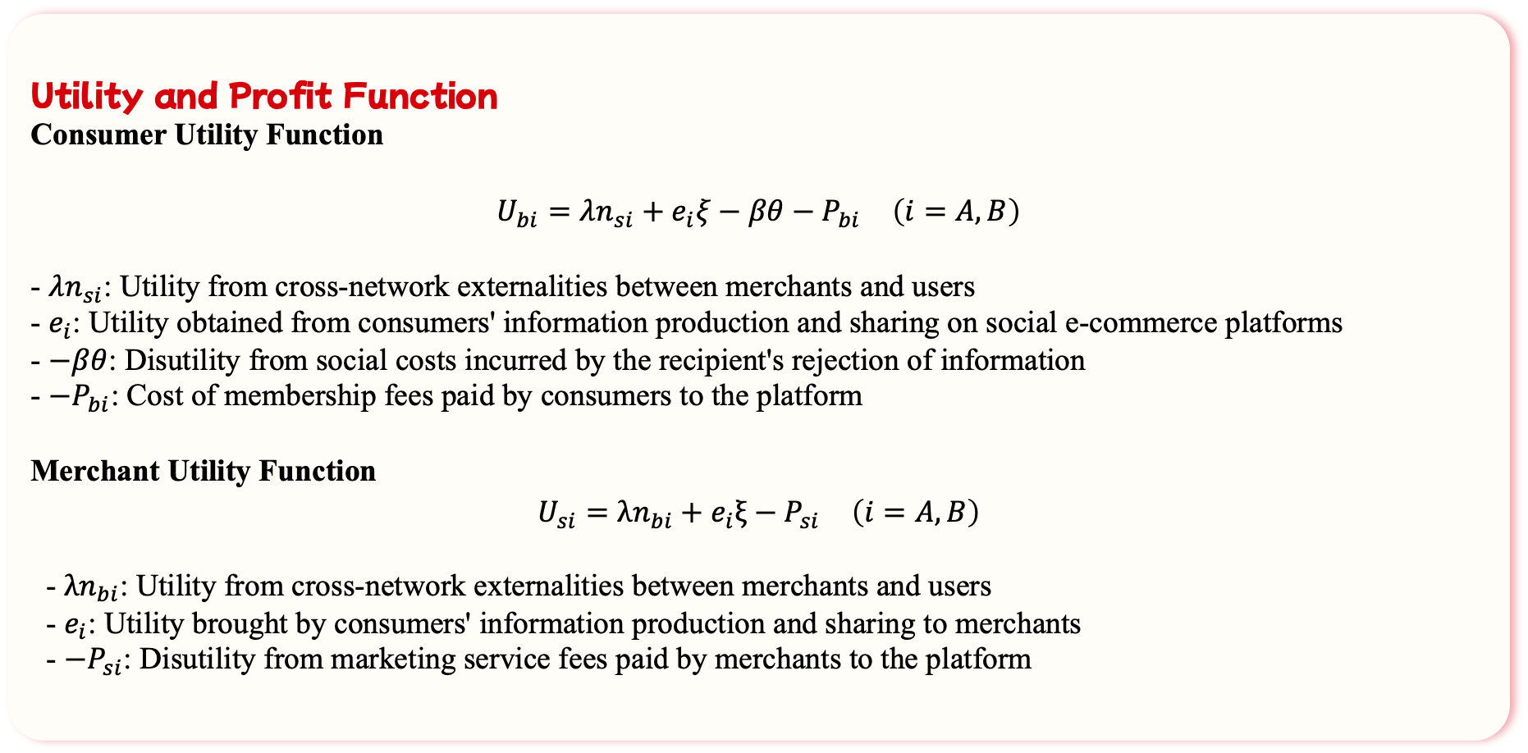
2.2.2 Two-sided Market Pricing
Utility and Profit Function
Consumer Utility Function
$$U_{bi}=λn_{si}+e_{i}ξ−βθ−P_{bi} \left(i=A,B\right)$$
- $λn_{si}$: Utility from cross-network externalities between merchants and users
- $e_{i}$: Utility obtained from consumers' information production and sharing on social e-commerce platforms
- $−βθ$: Disutility from social costs incurred by the recipient's rejection of information
- $−P_{bi}$: Cost of membership fees paid by consumers to the platform
Merchant Utility Function
$$U_{si}=λn_{bi}+e_{i}ξ−P_{si} \left(i=A,B\right)$$
- $λn_{bi}$: Utility from cross-network externalities between merchants and users
- $e_{i}$: Utility brought by consumers' information production and sharing to merchants
- $−P_{si}$: Disutility from marketing service fees paid by merchants to the platform

Slide 18
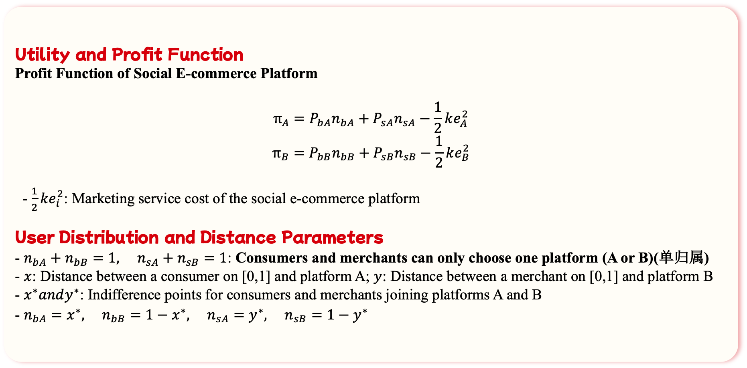
2.2.2 Two-sided Market Pricing
Utility and Profit Function
Profit Function of Social E-commerce Platform
$$π_{A}=P_{bA}n_{bA}+P_{sA}n_{sA}−\frac{1}{2}ke_{A}^{2}$$
$$π_{B}=P_{bB}n_{bB}+P_{sB}n_{sB}−\frac{1}{2}ke_{B}^{2}$$
- $\frac{1}{2}ke_{i}^{2}$: Marketing service cost of the social e-commerce platform
User Distribution and Distance Parameters
- $n_{bA}+n_{bB}=1, n_{sA}+n_{sB}=1$: Consumers and merchants can only choose one platform (A or B)(单归属)
- $x$: Distance between a consumer on [0,1] and platform A; $y$: Distance between a merchant on [0,1] and platform B
- $x^{∗}andy^{∗}$: Indifference points for consumers and merchants joining platforms A and B
- $n_{bA}=x^{∗}, n_{bB}=1−x^{∗}, n_{sA}=y^{∗}, n_{sB}=1−y^{∗}$

Slide 19
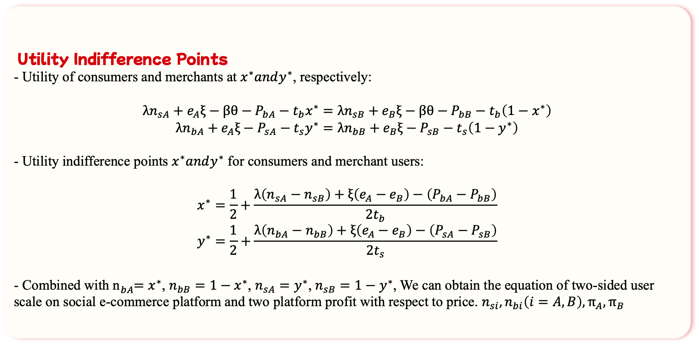
2.2.2 Two-sided Market Pricing
Utility Indifference Points
- Utility of consumers and merchants at $x^{∗}andy^{∗}$, respectively:
$$λn_{sA}+e_{A}ξ−βθ−P_{bA}−t_{b}x^{∗}=λn_{sB}+e_{B}ξ−βθ−P_{bB}−t_{b}\left(1−x^{∗}\right)$$
$$λn_{bA}+e_{A}ξ−P_{sA}−t_{s}y^{∗}=λn_{bB}+e_{B}ξ−P_{sB}−t_{s}\left(1−y^{∗}\right)$$
- Utility indifference points $x^{∗}andy^{∗}$ for consumers and merchant users:
$$x^{∗}=\frac{1}{2}+\frac{λ\left(n_{sA}−n_{sB}\right)+ξ\left(e_{A}−e_{B}\right)−\left(P_{bA}−P_{bB}\right)}{2t_{b}}$$
$$y^{∗}=\frac{1}{2}+\frac{λ\left(n_{bA}−n_{bB}\right)+ξ\left(e_{A}−e_{B}\right)−\left(P_{sA}−P_{sB}\right)}{2t_{s}}$$
- Combined with n${}_{bA}^{}=x^{∗}$, $n_{bB}=1−x^{∗}$, $n_{sA}=y^{∗}$, $n_{sB}=1−y^{∗}$, We can obtain the equation of two-sided user scale on social e-commerce platform and two platform profit with respect to price. $n_{si},n_{bi}\left(i=A,B\right),π_{A},π_{B}$

Slide 20
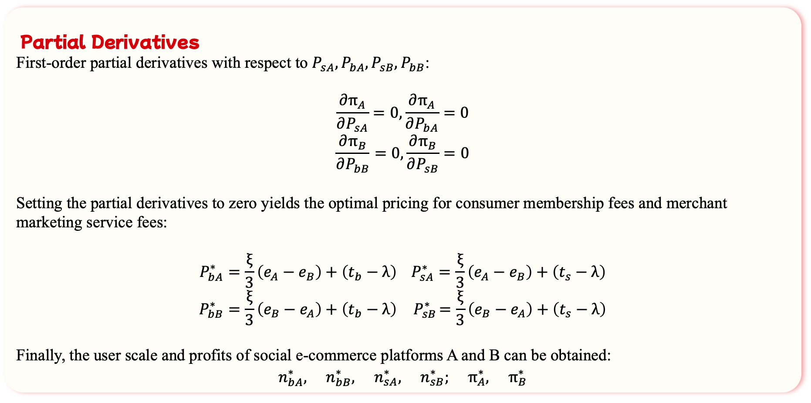
2.2.2 Two-sided Market Pricing
Partial Derivatives
First-order partial derivatives with respect to $P_{sA},P_{bA},P_{sB},P_{bB}$:
$$\frac{∂π_{A}}{∂P_{sA}}=0,\frac{∂π_{A}}{∂P_{bA}}=0$$
$$\frac{∂π_{B}}{∂P_{bB}}=0,\frac{∂π_{B}}{∂P_{sB}}=0$$
Setting the partial derivatives to zero yields the optimal pricing for consumer membership fees and merchant marketing service fees:
$$P_{bA}^{∗}=\frac{ξ}{3}\left(e_{A}−e_{B}\right)+\left(t_{b}−λ\right) P_{sA}^{∗}=\frac{ξ}{3}\left(e_{A}−e_{B}\right)+\left(t_{s}−λ\right)$$
$$P_{bB}^{∗}=\frac{ξ}{3}\left(e_{B}−e_{A}\right)+\left(t_{b}−λ\right){ P}_{sB}^{∗}=\frac{ξ}{3}\left(e_{B}−e_{A}\right)+\left(t_{s}−λ\right)$$
Finally, the user scale and profits of social e-commerce platforms A and B can be obtained:
$$n_{bA}^{∗}, n_{bB}^{∗}, n_{sA}^{∗}, n_{sB}^{∗}; π_{A}^{∗}, π_{B}^{∗}$$

Slide 21
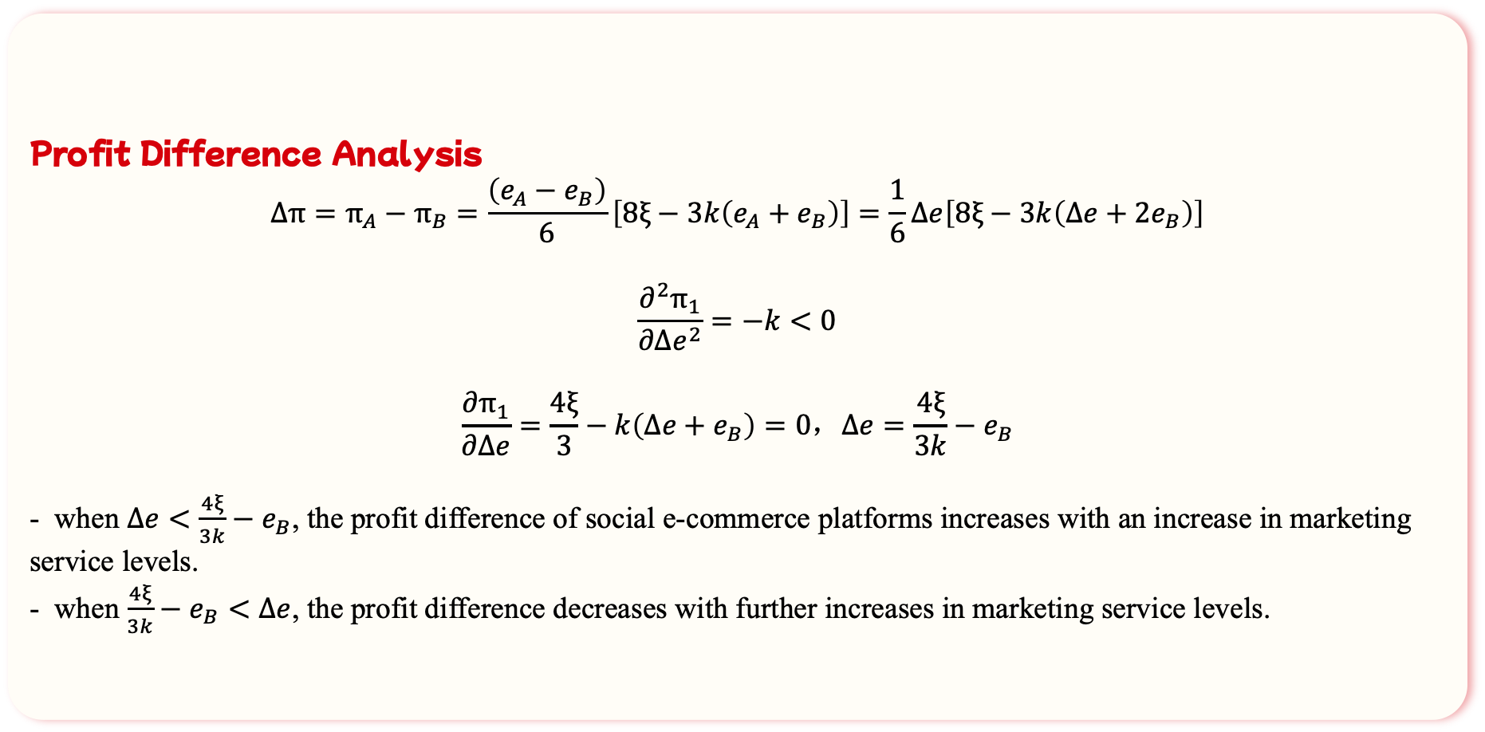
2.2.2 Two-sided Market Pricing
Profit Difference Analysis
$$Δπ=π_{A}−π_{B}=\frac{\left(e_{A}−e_{B}\right)}{6}\left[8ξ−3k\left(e_{A}+e_{B}\right)\right]=\frac{1}{6}Δe\left[8ξ−3k\left(Δe+2e_{B}\right)\right]$$
$$\frac{∂^{2}π_{1}}{∂Δe^{2}}=−k<0$$
$$\frac{∂π_{1}}{∂Δe}=\frac{4ξ}{3}−k\left(Δe+e_{B}\right)=0，Δe=\frac{4ξ}{3k}−e_{B}$$
- when $Δe<\frac{4ξ}{3k}−e_{B}$, the profit difference of social e-commerce platforms increases with an increase in marketing service levels.
- when $\frac{4ξ}{3k}−e_{B}<Δe$, the profit difference decreases with further increases in marketing service levels.

Slide 22
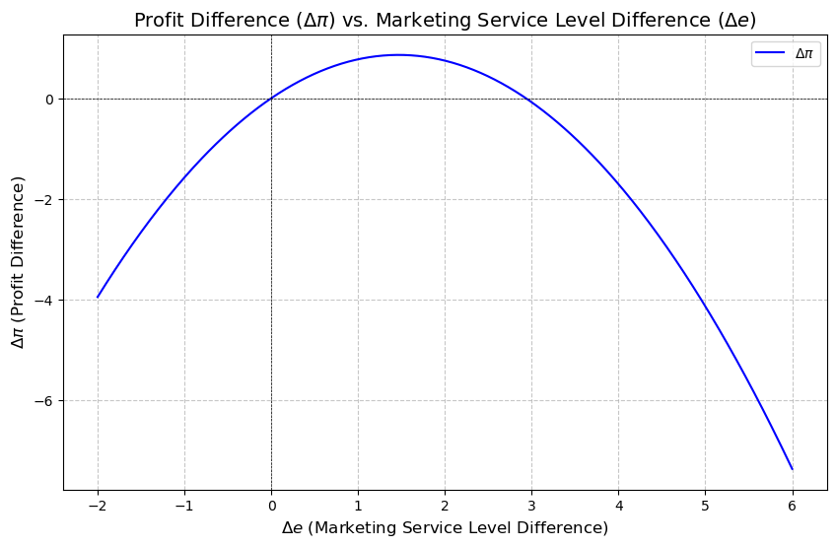
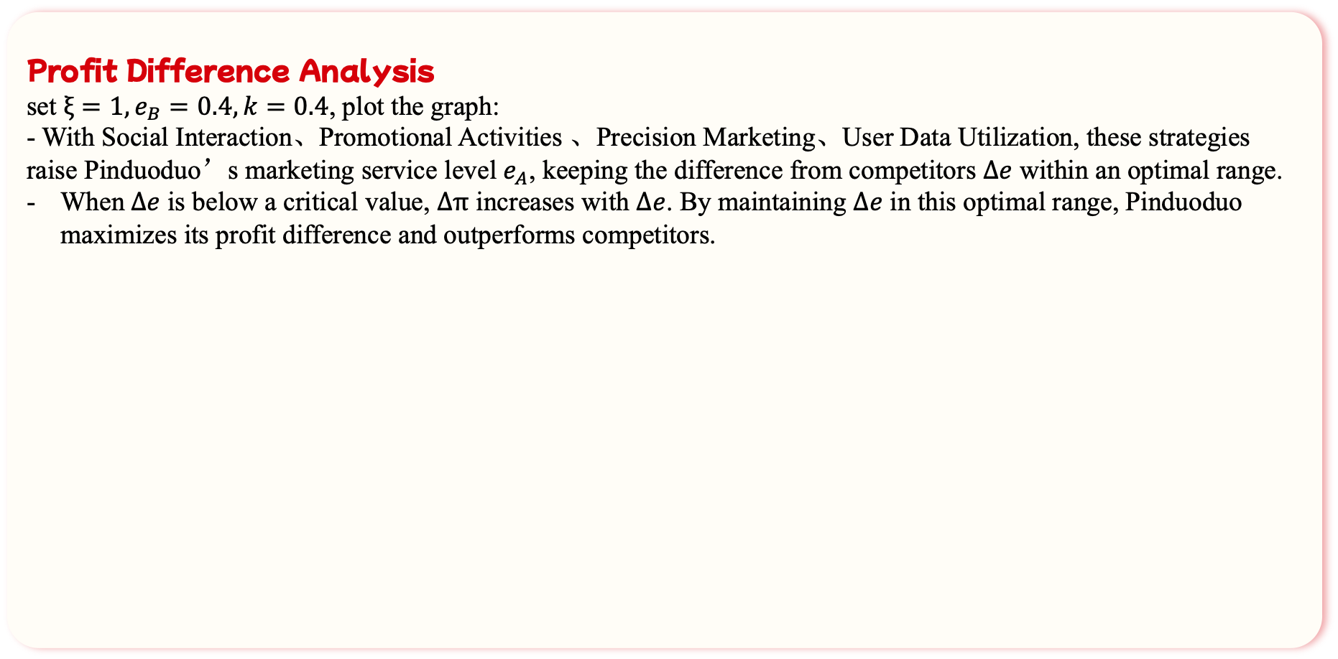
2.2.2 Two-sided Market Pricing
Profit Difference Analysis
set $ξ=1,e_{B}=0.4,k=0.4$, plot the graph:
- With Social Interaction、Promotional Activities 、Precision Marketing、User Data Utilization, these strategies raise Pinduoduo’s marketing service level $e_{A}$, keeping the difference from competitors $Δe$ within an optimal range.
When$Δe$ is below a critical value, $Δπ$ increases with $Δe$. By maintaining $Δe$ in this optimal range, Pinduoduo maximizes its profit difference and outperforms competitors.

Slide 23



2.3.1 Mechanism of the online reputation system
Mechanism
Buyer
Seller
Platform
5🌟 Rating
+
Sales Volume
Ranking list📝
Low rating governance
DSR index
Signal
Purchase
If twisted
Service(40%)Praoduct(40%)Logistics(20%)
Evaluation
Review
Report⚠️
Store will be degraded if DSR < 4.5
BUT！
Head e-commerce complaint rate
WHY?
Price war: Low-price strategy attracts counterfeit goods.
Platform squeezes merchants: High algorithm and advertising costs.
Difficulty in regulation: Huge data & dispersed merchants.
Complaint rate of Pinduoduo is the highest.
Notes:
Pinduoduo has been working hard to build a trustworthy online shopping environment.
First , let's understand how Pinduoduo's reputation system works.
When customers purchase items on Pinduoduo, they can leave evaluations based on their shopping experience. Sellers can view and respond to these reviews. They can also report any twisted or false reviews to the platform for further action. Pinduoduo ranks sellers based on a combination of their ratings and sales volume. The DSR index is based on Service Quality, Product Quality, and Logistics Efficiency. If a seller's DSR drops below 4.5, their store is downgraded and lose platform visibility and traffic. This signal ensures sellers maintain quality standards.
Despite these efforts, data shows that Complaint rate of Pinduoduo is the highest among all head e-commerce platforms. Why? The high complaint rate is due to its low-price strategy attracting counterfeit goods, squeezing merchants via high algorithm and advertising costs, and regulatory difficulties from vast data and dispersed merchants.

Slide 24



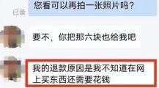

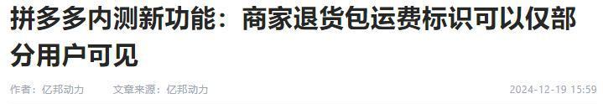
“New brand plan2.0” + “Billion subsidy”
Seller: counterfeit products
2.3.2 Risk of online reputation system
Problem
Solution
Support sub-brands of well-known brands, boost new industrial belt brands, and revitalize old domestic brands.
Billion Subsidy focuses on digital 3C, offering the lowest prices and authentic reputation.
Adverse selection: Low-quality products squeeze out high-quality.
Rich fake range: Fakes cover clothing, electronic appliances and many other categories.
Weak brand concept: platform focuses more on goods.
Buyer: "Refund only" policy
“Selected user plan”
Consumer filtering: Eliminate low- quality consumers who engage in wool- harvesting(薅羊毛).
Official policy: State Administration for Market Regulation has urged platform to avoid squeezing merchants.
Moral hazard: Buyer can buy products impulsively given the customer-oriented policy.
Notes:
Pinduoduo's reputation system faces several risks that need to be managed carefully.
● From Seller side, PDD‘s counterfeit products cover various categories like clothing and electronics. Additionally, Pinduoduo's weak brand concept focuses more on goods themselves rather than brand image.
From Buyer side, The "refund-only" policy protects consumers but some buyers may exploit it for refunds, leading to moral hazards.
To address these risks,
● For Sellers, Pinduoduo's "New Brand Plan" supports sub-brands of famous brands, boosts new brands, and revitalizes old domestic brands. Its "Billion Subsidy" program offers low prices and authentic quality to encourage sellers to maintain high standards.
● For Buyers, Pinduoduo has introduced the "Selected User Plan". This plan filters out low-quality consumers who engage in wool-harvesting. The State Administration for Market Regulation also noticed the problem and has urged platform to avoid squeezing merchants.
In summary, Despite challenges like counterfeits and buyer exploitation, Pinduoduo's reputation system aims to build trust and quality.

Slide 25
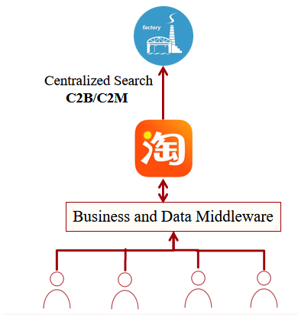
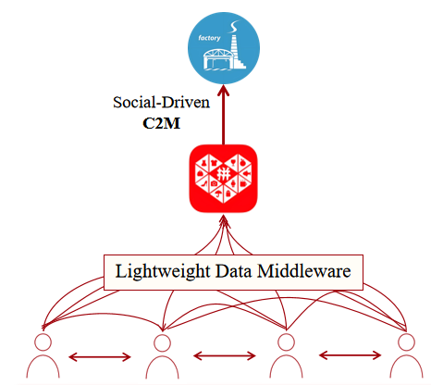
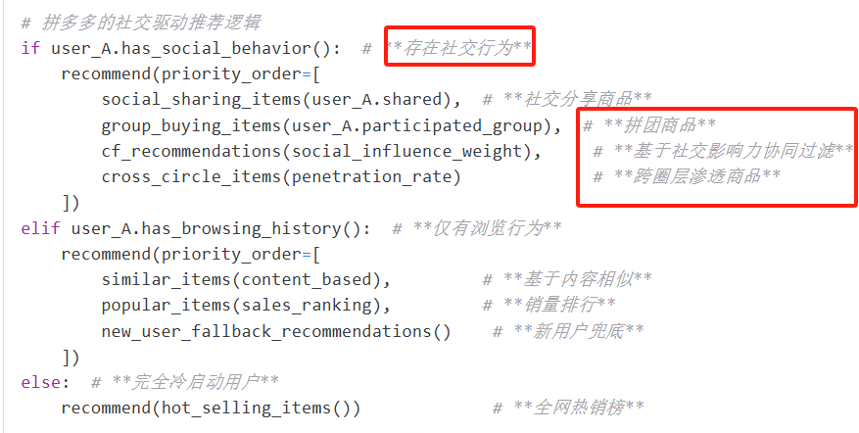
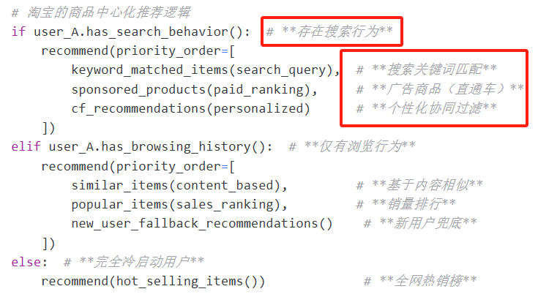


2.4.1 Recommended System
Content-based Filtering
+Collaborative Filtering
Consumer
Consumer
Product
product
Taobao
1.Mechanism: A buy X, B buy X+Y, recommend Y to A
2. Collaborative Filtering: only based on behavioral similarities
3.Data: Inability to obtain real social relationships
PDD
1.Mechanism: A views X, B’s pintuan includes X+Y → Push Y to A with discount + peer pressure
2.Collaborative Filtering(More Social influence weight) Better!
3.Data: Social weight +Penetration rate across different social strata
PDD do better at cold start, data, and user group target...
25

Slide 26
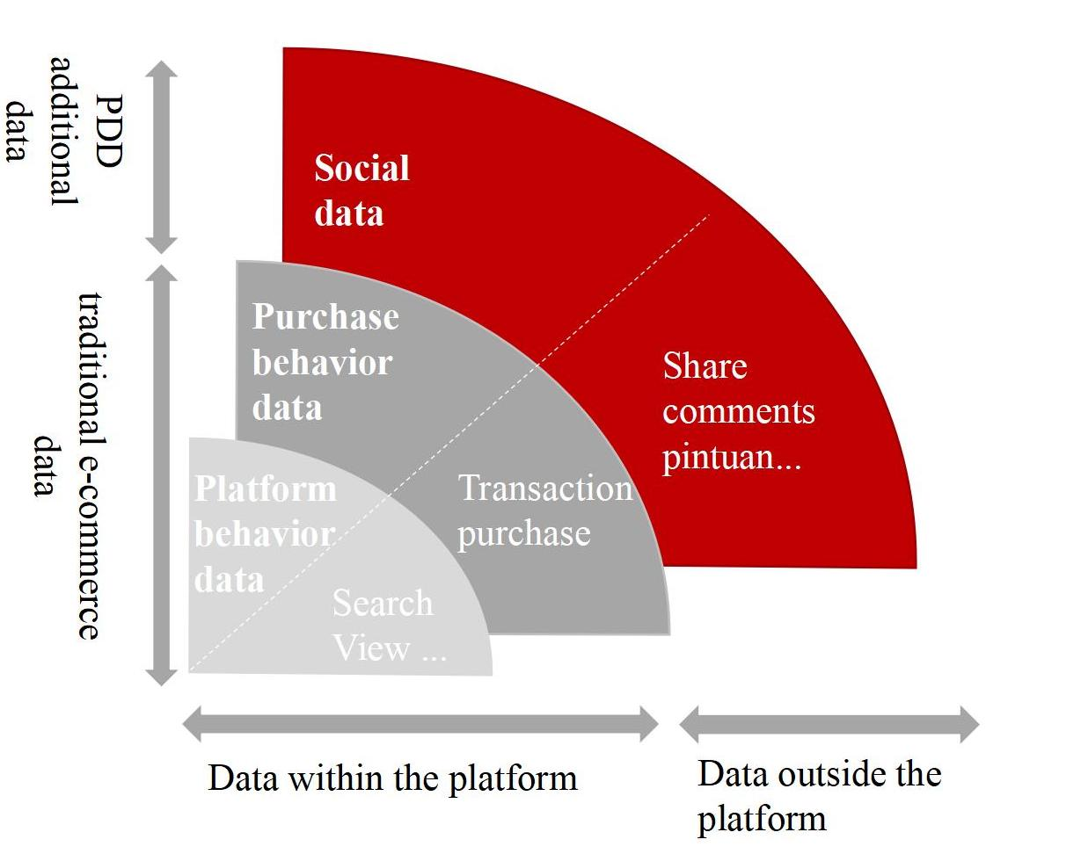
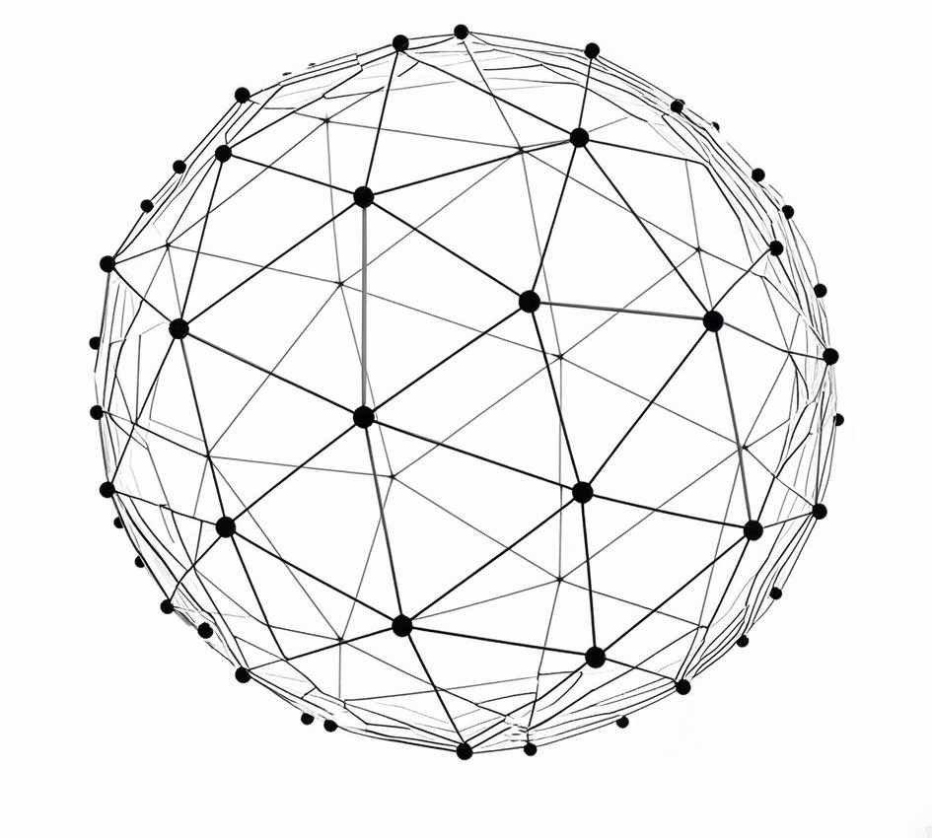
2.4.2 Algorithm differences
零售电商发展阶段
Data input
Distributed AI
1.Taobao: Platform centralization algorithm, focus on products to Collect, calculate, and distribute data.
2. PDD: people-oriented algorithm, use distributed AI can deeply understand users and enhance the algorithm by utilizing pintuan data and social relationships.
26

Slide 27
PART 03
Extension
PINDUODUO
Team Up, Price Down!
Team Up for Savings | Deals | Welcome Surprises !
Notes:
Based on the theretical analysis, we can actually solve the question of why PDD can take off. Now we are going to do some extension

Slide 28
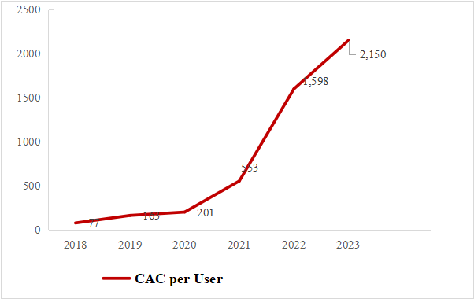

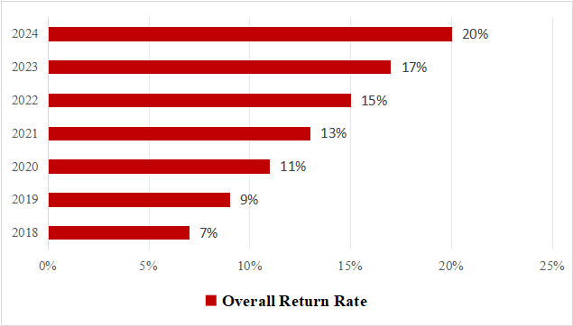
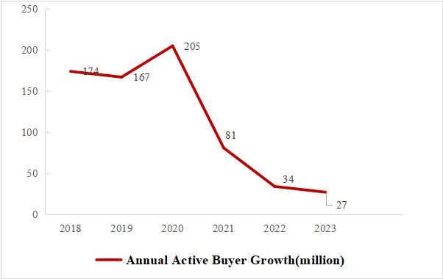
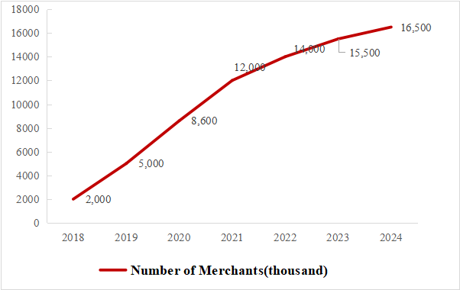
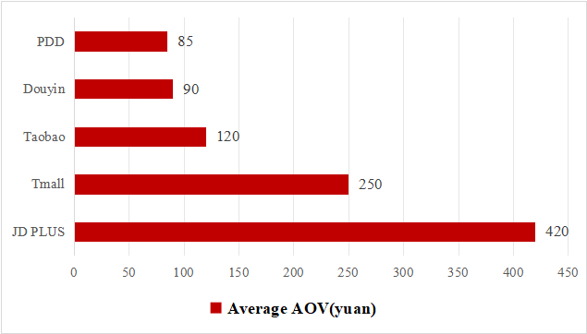

3.1 Can PDD’s path to success be replicated ? Difficult!
1. Social Media Dividend Depletion: User virality willingness declined.
2. Public Traffic Ceiling:
Short videos now account for 70% of user screen time（Before ＜ 15%).
1. Industrial Cluster Saturation:
16.5 million merchants , profit margins ＜5%.
2. Strengthened Quality Oversight:
Regulations require platforms to conduct sampling inspections on 50% of products.
1. Downstream Market:
Highly price-sensitive but demands quality upgrades.
2. Mid-to-High-End Market:
Rejects "low price, low quality", pay for trust
Notes:
Can PPD; path to success be replicated, no !
The data has shown that PDD has reached to a bottleneck, on the CAC annual active buyer and other feature.
Which meas the social media profit has disappeared for e-commerce platform.

Slide 29


Inbalance of bilateral market
Reconstruction of price equilibrium
3.2 What is the future direction of PDD ?
Core problem: growth break
Breakthrough: triple equilibrium
Attenuation of network effect
1. Demand side
Price Anchoring
2. Supply side
Prisoner's Dilemma
Upscale of quality equilibrium
Price Discrimination
Sinking market: Keep prices under 50 & quality grading label.
Mid-to-high-end market: Create a "quality zone" where merchants can charge 30% more.
3. Platform side
Inbalance of pricing structure
Failure of ecological governance
Optimization of governance equilibrium
Signaling Theory
C2M 2.0: Set up a Quality Co-research Fund to subsidize merchants.
Elimination Mechanism: Charge a quality deposit for merchants with a return rate exceeding 15%, compelling supply chain upgrades.
User growth
Merchant retention
Quality dispute
Doubts about fakes undermine the platform's credibility.
Policy risk
Conflict btw nature of public goods & private interests.
Polycentric Governance
Merchant co-governance Committee: Invite TOP50 merchants to participate in the rule-making and voting.
Consumer empowerment: Launch Quality Crowdfunding where users can advance funds in product design.
Notes:
We can see that the core problem of PDD is growth break.
How to breakthrough ? Main is to do the price quality and governmence.
Keep the basic low price logic and increase the quality is the first choice.

Slide 30
PART 04
Conclusion
PINDUODUO
Team Up, Price Down!
Team Up for Savings | Deals | Welcome Surprises !

Slide 31
4. Conclusion
Why Did PDD Take Off ?
Theoretical Analysis
How does PDD deal with the problem of fakes ? (see the online reputation system)
1. Network Effect
Direct & Indirect Network Effects Cycle
2. Platform Pricing
C2M model
3. Online Reputation
“New brand plan2.0” + “Billion subsidy”
4. Recommendation System
Associate with the social data
Extension
Can PDD’s path to success be replicated ? No !
What is the future direction of PDD ? Pricing, Quality and Governance Combination.
Notes:
Now we can draw the conclusion:
In this project we fully answer the question why did pdd take off ?
From 4 apects network effect, prcing , reputaion and recom. We also did some discussions based on the PDD oeprating logic.

Slide 32
PINDUODUO
Thank You
April 18th, 2025
Group 1: Kai Ren, PeiHua Ji, JunWen Luo, FeiFan Xu,
Lei Cheng, Chang Li
Team Up, Price Down!
Team Up for Savings | Deals | Welcome Surprises !
Notes:
So, this is all of our project, thank you guys.

